Slide 1
Unveiling the Organic Evolution:
A Deep Dive into EU Food Trends
CAPSTONE PRESENTATION
Adam Ayaita
Sasan Eftekhar
Victor Kozlov
André Malotta
Otaro David Namakwa
March 1, 2024

Slide 2
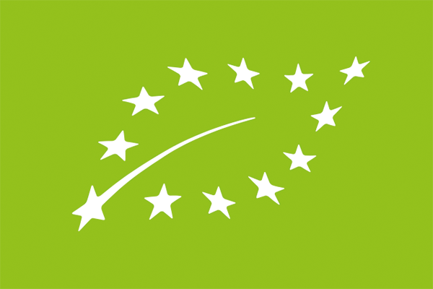
Introduction
Organic food
= food produced with organic farming
Overall system of farm management and food production that combines:
best environment practices,
high level of biodiversity,
preservation of natural resources,
application of high animal welfare standards.
Information source:
European Commission (https://agriculture.ec.europa.eu/farming/organic-farming/organic-production-and-products_en)

Slide 3
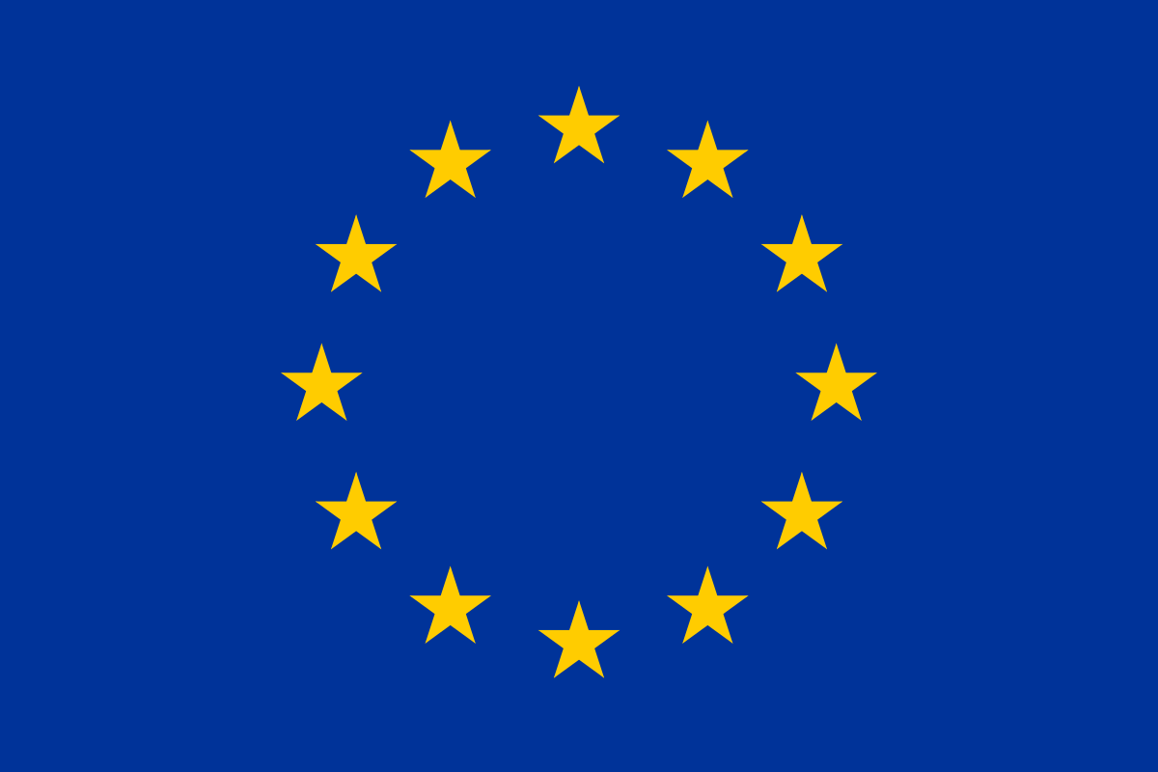
Business motivation and questions
Should I produce organic or conventional food?
Food producer in the EU
How is the demand for organic (vs. conventional) food developing in the EU?
How much higher prices can I get for organic (vs. conventional) food in the EU?
What consumer expectations should I fulfill if I want to produce organic food for the EU market?

Slide 4
Hypotheses
The demand for organic (vs. conventional) foods in the EU has increased.
Increased health and environmental concerns
Expanded chain of distribution for organic foods
The growth of the demand for organic (vs. conventional) foods has weakened after 2020.
Negative effect of inflation on demand for more expensive products
Prices for organic (vs. conventional) eggs and milk in the EU are decreasing.
Intensified competition due to growing number of organic food producers
Price pressure from large retailers
Motives for buying organic foods (among those who buy them) include health and environmental concerns.

Slide 5
How is the demand for organic (vs. conventional) food developing in the EU?
Production

Slide 6
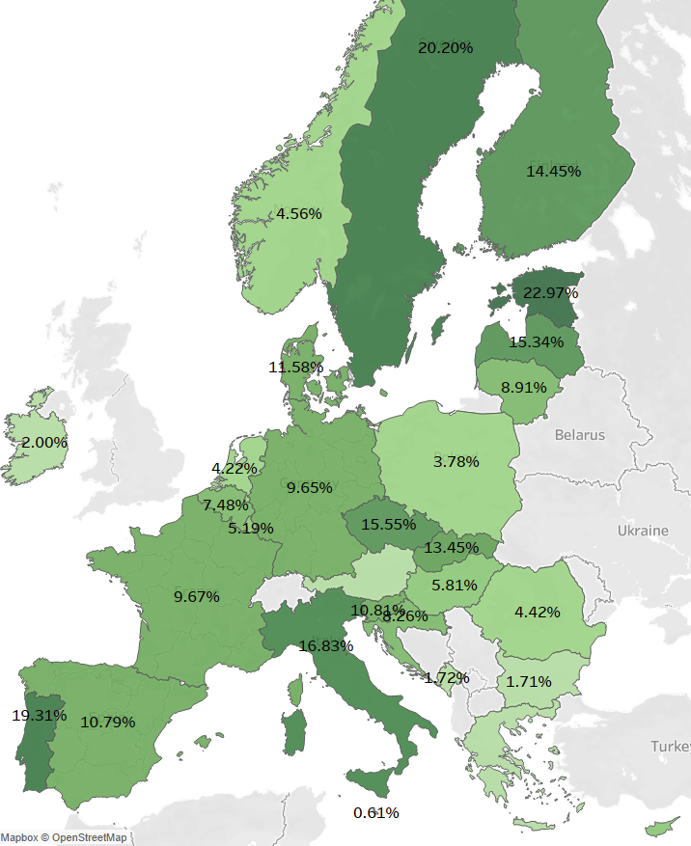
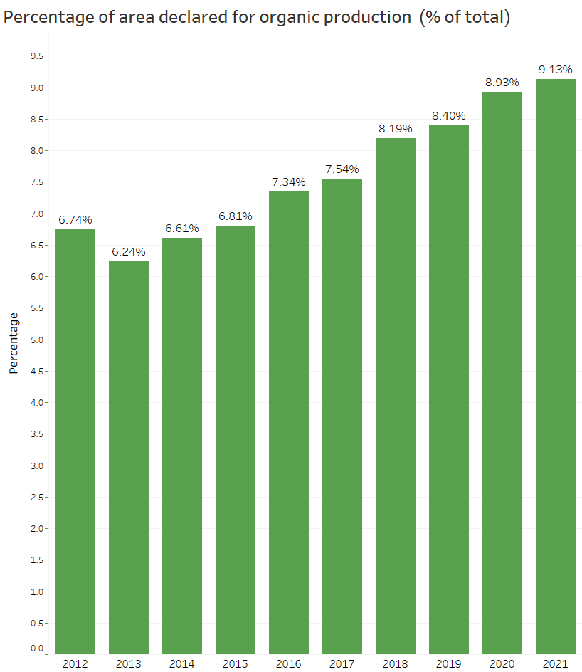
Percentage of agricultural area declared for organic production in EU: increase over time, especially since 2014
% of total agricultural area in 2021 per country
The total area has increased from 6.7% in 2012 to 9.1% in 2021.
Number of companies in organic food production: increase from 310,434 in 2013 to 397,091 in 2021
Data: from Eurostat*;
EU 27 countries;
N = 324 cases
* https://ec.europa.eu/eurostat/databrowser/product/view/sdg_02_40?category=t_agr.t_org

Slide 7
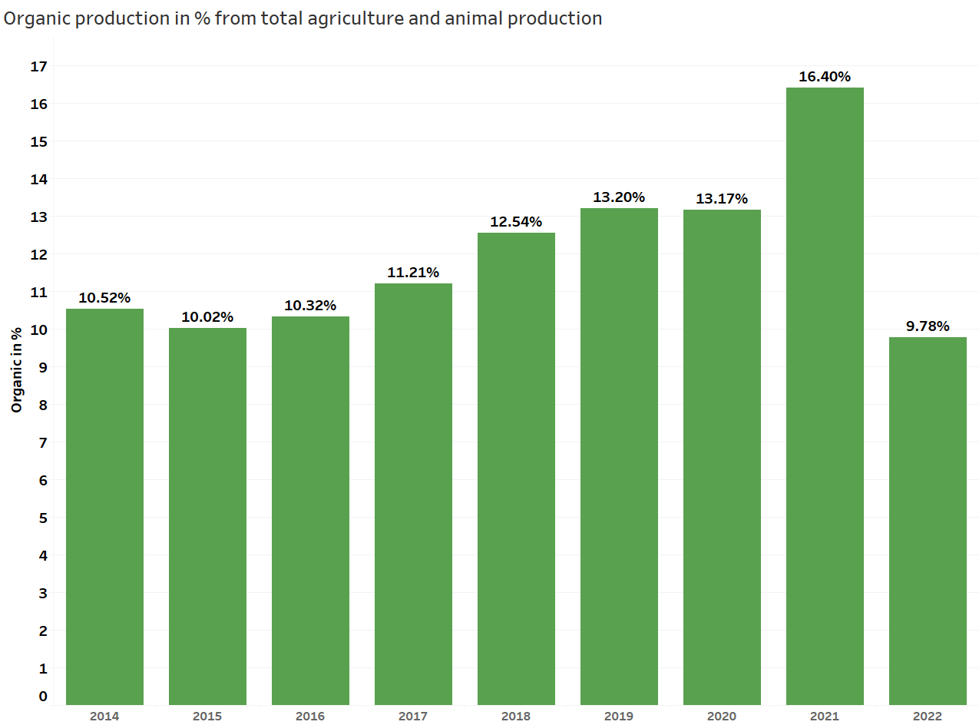
Share of organic food volume (relative to total production volume) increasing until 2021, then drop again
The combined volume of organic and conventional food production in 2022 was over 798 million tonnes.
78.1 million tonnes (9.78%) are organic products.
Data: from Eurostat*;
EU 27 countries;
N = 968,385 cases
* https://ec.europa.eu/eurostat/en/data/database?node_code=org

Slide 8
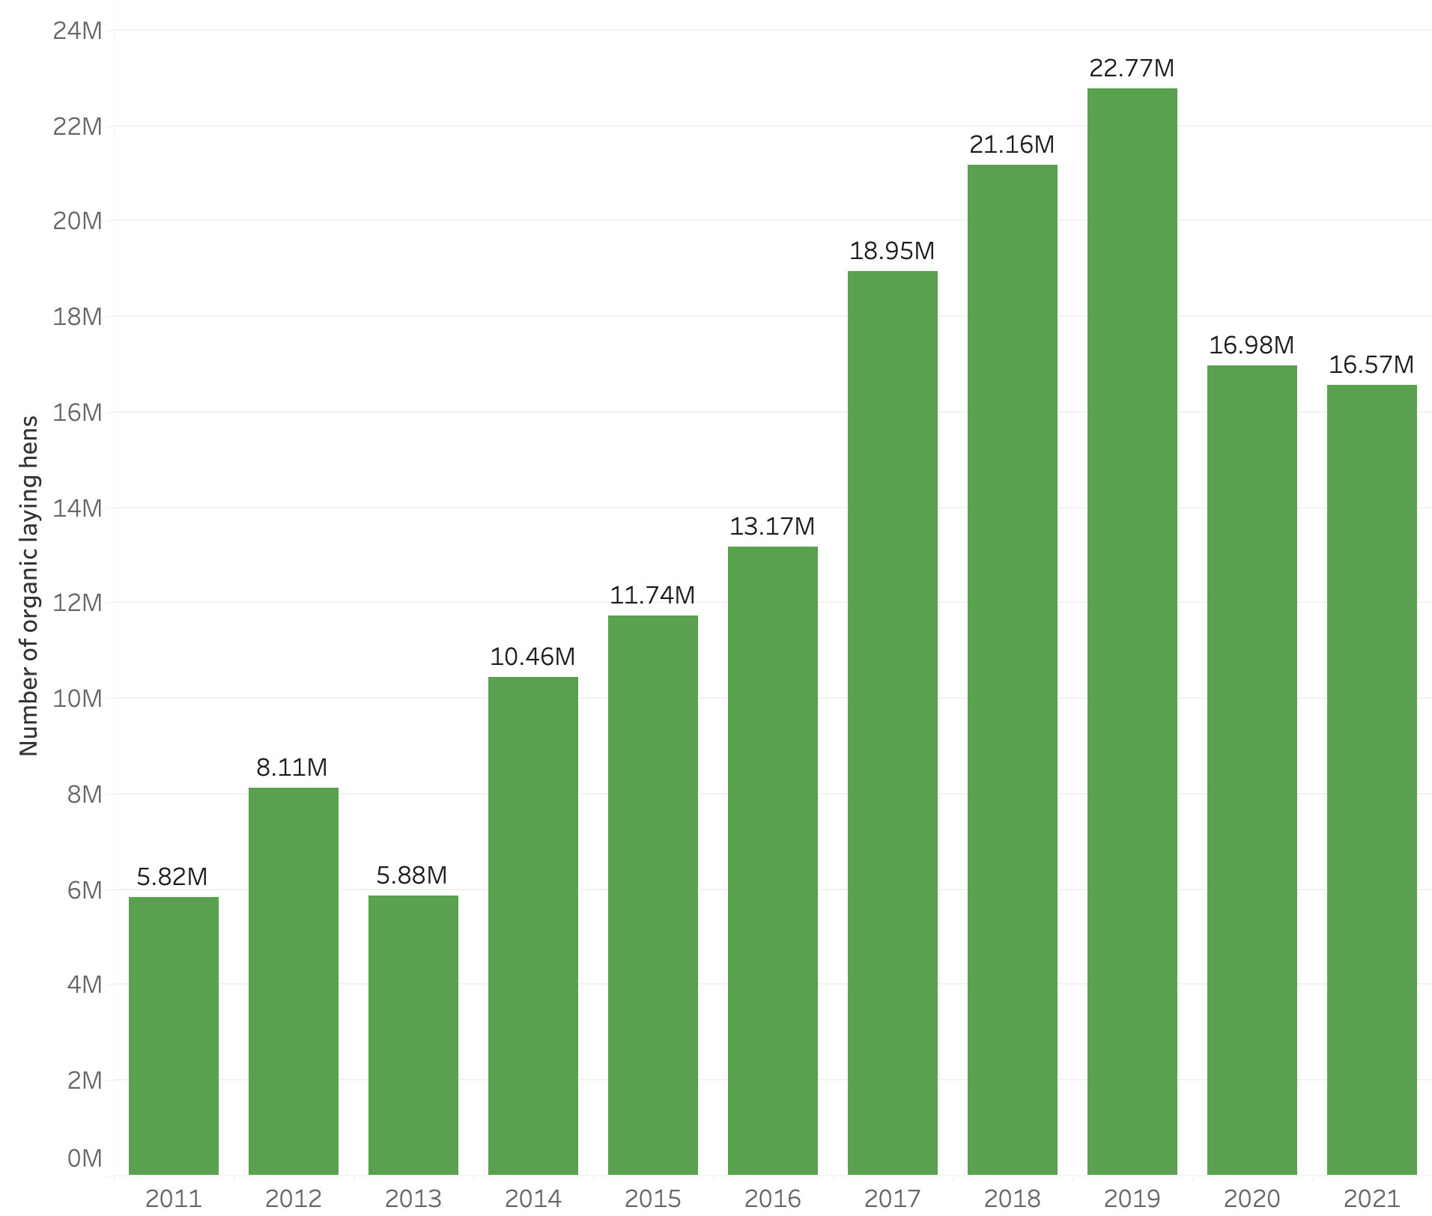
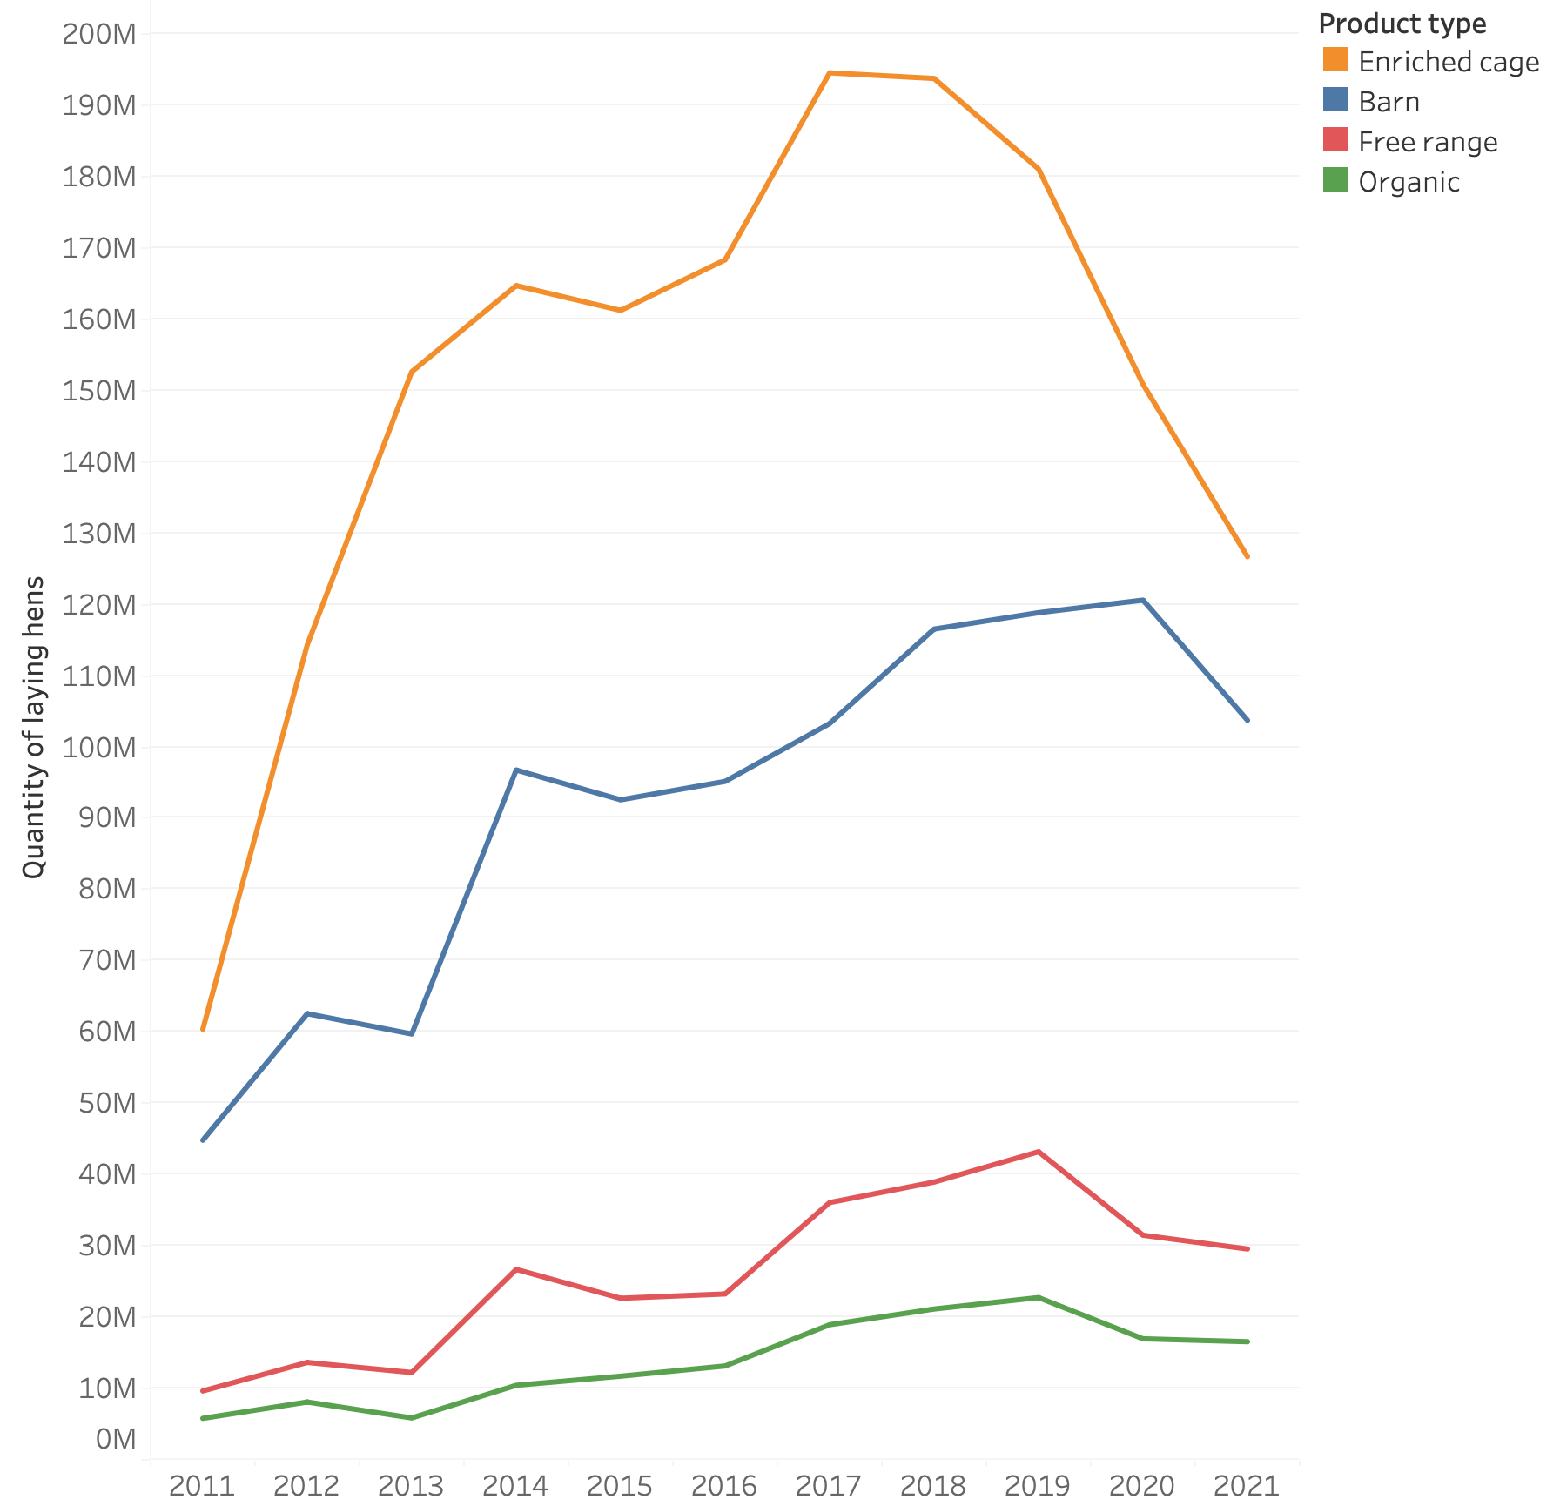
Number of laying hens in EU: increase in organic hens
(until 2019) and recent drop in conventional hens
Data: from Eurostat*;
EU 27 countries;
N = 991 cases
* https://ec.europa.eu/eurostat/databrowser/view/org_lstspec/default/table?lang=en

Slide 9
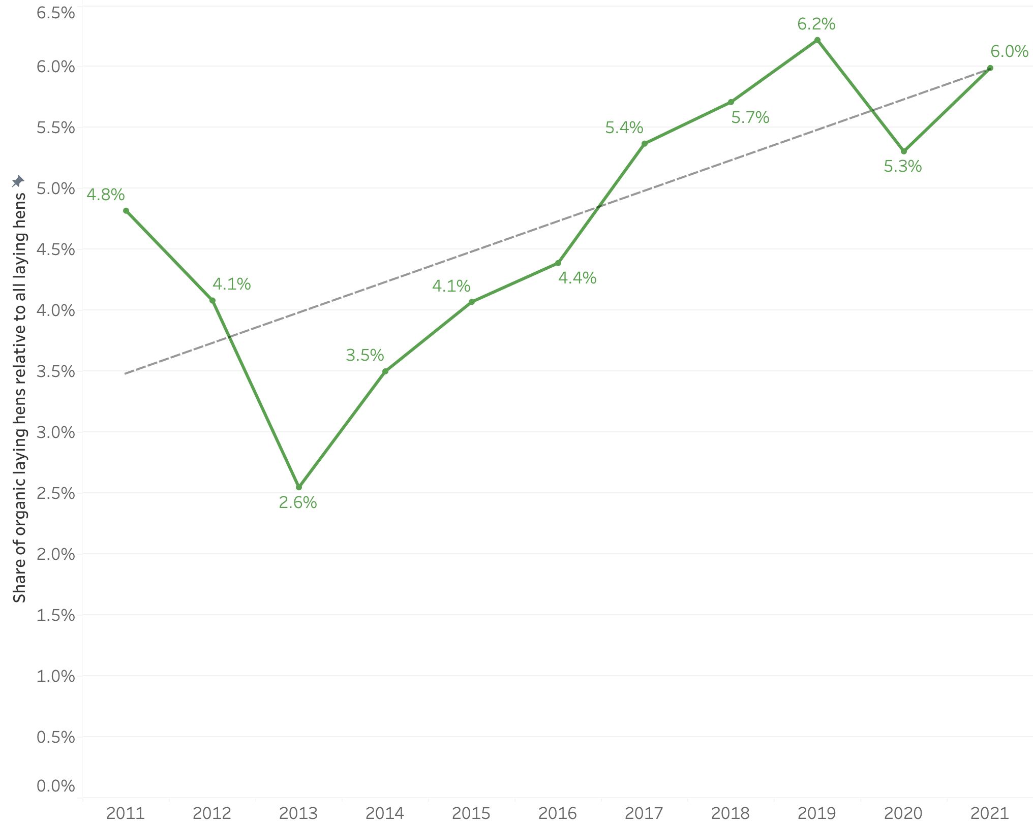
Share of organic laying hens in EU: generally increasing, especially until 2019
Between 2013 and 2019 the share of organic laying hens increased from 2.6% to 6.2%.
In 2021 the share of laying hens was 6.0% of the total.
Data: from Eurostat*;
EU 27 countries;
N = 991 cases
* https://ec.europa.eu/eurostat/databrowser/view/org_lstspec/default/table?lang=en

Slide 10
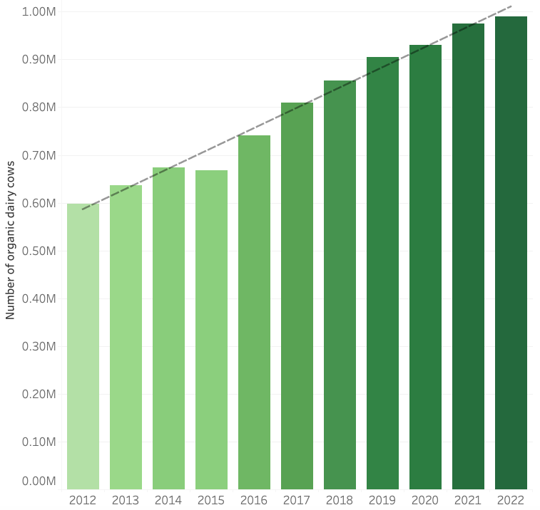
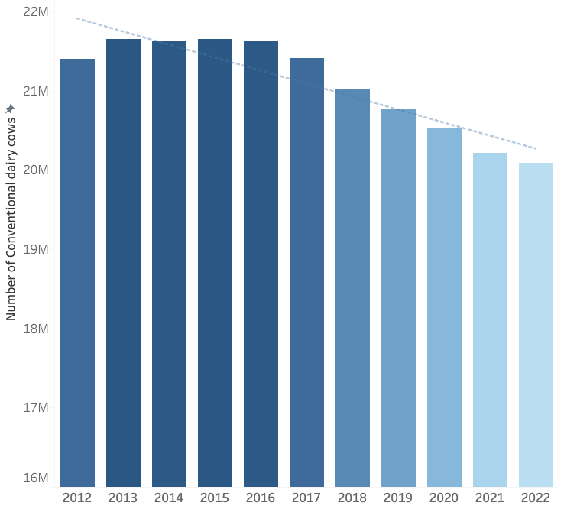
Number of dairy cows in EU: increasing for organic and decreasing for conventional cows
The number of organic dairy cows in EU increased by 0.39 million in ten years.
The number of conventional dairy cows in EU decreased by 1.32 million in ten years.
Data: from Eurostat*; EU 27 countries except Malta and Slovenia; N = 297 cases
* https://ec.europa.eu/eurostat/databrowser/view/org_lstspec/default/table?lang=en

Slide 11
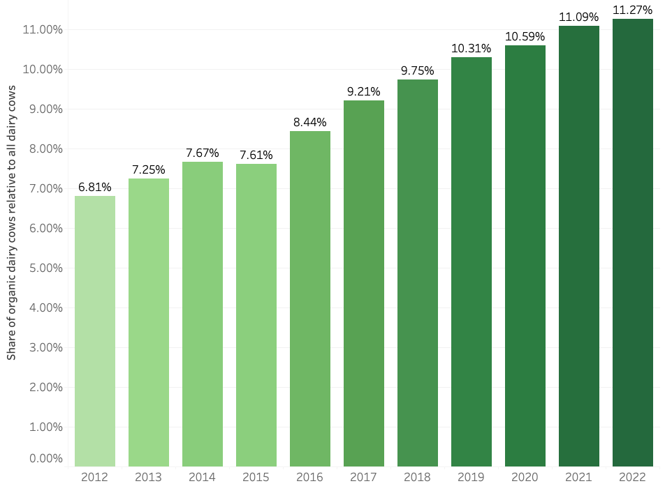
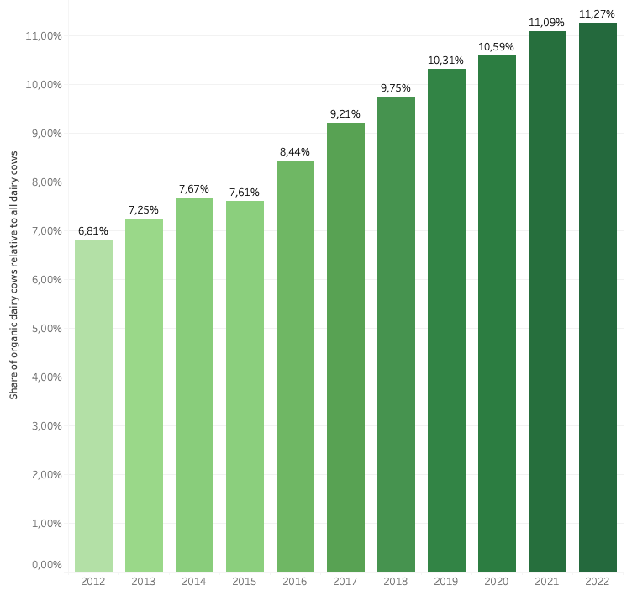
Share of organic dairy cows in EU: increasing each year
In 2012 the share of organic cows was 6.81% of the total.
In 2022 the share of organic cows was 11.27% of the total.
Share of organic dairy cows in EU grew at an avg. rate of
0.45 pp percent per year (4.46 pp in ten years).
Data: from Eurostat*;
EU 27 countries except Malta and Slovenia;
N = 297 cases
* https://ec.europa.eu/eurostat/databrowser/view/org_lstspec/default/table?lang=en

Slide 12
How is the demand for organic (vs. conventional) food developing in the EU?
Sales

Slide 13
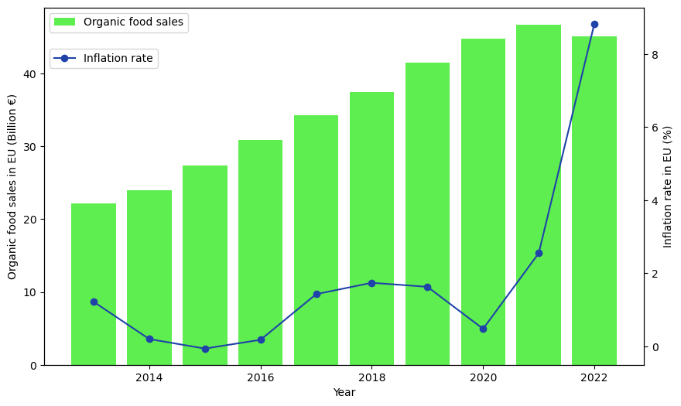
Sales of organic foods in EU: generally increasing
Increase until 2020, then rather stagnation
EU sales of organic foods from 22.1 billion € in 2013 to 45.1 billion € in 2022
Surge in inflation appears to have negative impact on growth of organic food sales.
Data: from Statista*;
EU 27
Inflation data: from IMF**;
EU 27
* https://www.statista.com/statistics/541536/organic-retail-sales-value-european-union-europe-statistic/
** https://www.imf.org/external/datamapper/PCPIPCH@WEO/OEMDC

Slide 14
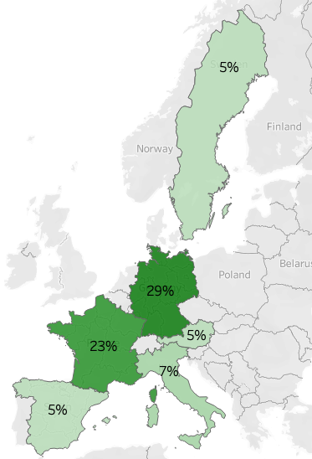
Germany is the largest organic food market in the EU.
EU countries ordered by organic food sales
(Top 6 ranking):
Germany →
France
Italy
Austria
Sweden
Spain
Numbers: share of organic food sales relative to total Europe
Data: from Statista*
* https://www.statista.com/statistics/632792/per-capita-consumption-of-organic-food-european-union-eu/

Slide 15
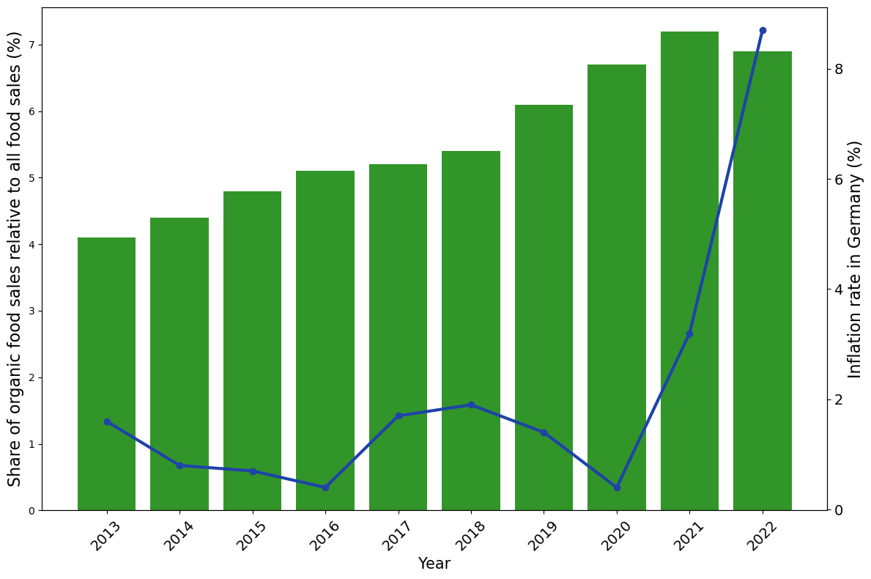
Market share of organic foods in Germany: generally increasing
Increase until 2020, then rather stagnation
Market share of organic foods in 2022: 6.9%
Surge in inflation appears to have negative impact on growth of organic food market share.
Sales data: from Statista*;
Germany
Inflation data: from IMF**;
Germany
* https://www.statista.com/statistics/1154312/organic-product-share-groceries-turnover-germany/
** https://www.imf.org/external/datamapper/PCPIPCH@WEO/OEMDC

Slide 16
How is the demand for organic (vs. conventional) food developing in the EU?
Consumption decisions & plans

Slide 17
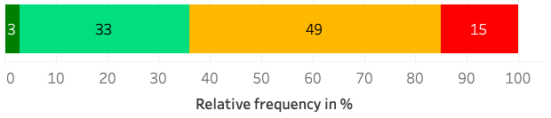

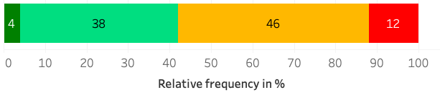
A growing share of consumers in Germany plans to buy organic foods frequently.
𝜮 Exclusively + Frequently:
36
Current frequency of buying organic foods:
Data:
from Eco Survey (Öko-Barometer) 2022 by German Federal Ministry of Food and Agriculture*;
Germany, age ≥ 14;
N = 1,014 respondents
Planned frequency of buying organic foods in the future:
42
+6
* https://www.bmel.de/SharedDocs/Downloads/DE/_Landwirtschaft/Biologischer-Landbau/oeko-barometer-2022-tabellenband.html

Slide 18

Hypotheses on demand supported
The demand for organic (vs. conventional) foods in the EU has increased.
Production Sales Consumption decisions & plans
The growth of the demand for organic (vs. conventional) foods has weakened after 2020.
Sales Market share

Slide 19
How much higher prices can I get for organic (vs. conventional) food in the EU?

Slide 20
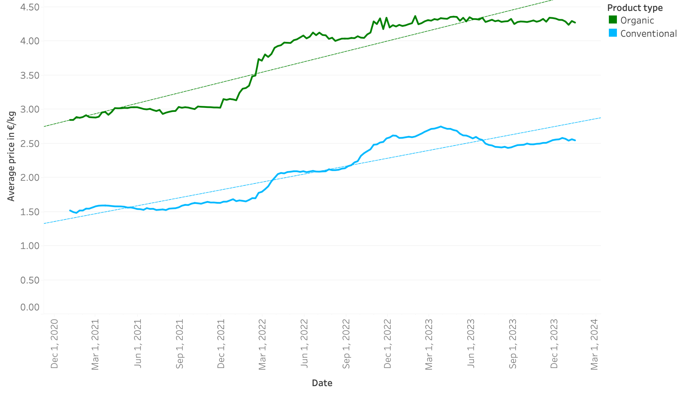
Eggs prices in EU: general increase (organic and conventional), especially around the beginning of 2022
Avg. prices in Jan 2024:
4.27 €/kg for organic eggs,
2.55 €/kg for conventional eggs
Data: from API “Agri-Food Markets” by European Commission*;
EU 27 countries except Luxembourg;
N = 11,968 cases
* https://agridata.ec.europa.eu/extensions/DataPortal/agricultural_markets.html

Slide 21
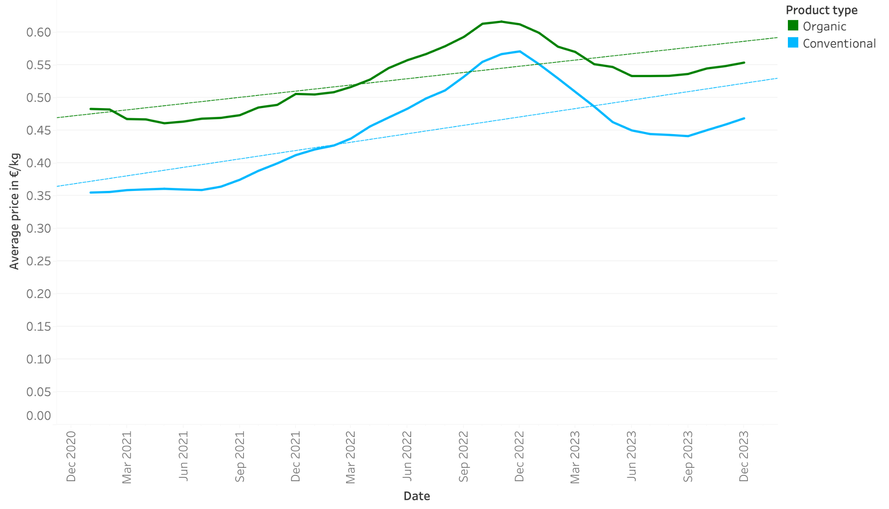
Milk prices in EU: general increase (organic and conventional) until end of 2022, then drop and increase
Avg. prices in Dec 2023:
0.55 €/kg for organic milk,
0.47 €/kg for conventional milk
Data: from API “Agri-Food Markets” by European Commission*;
EU 27 countries except Luxembourg;
N = 1,638 cases
* https://agridata.ec.europa.eu/extensions/DataPortal/agricultural_markets.html

Slide 22
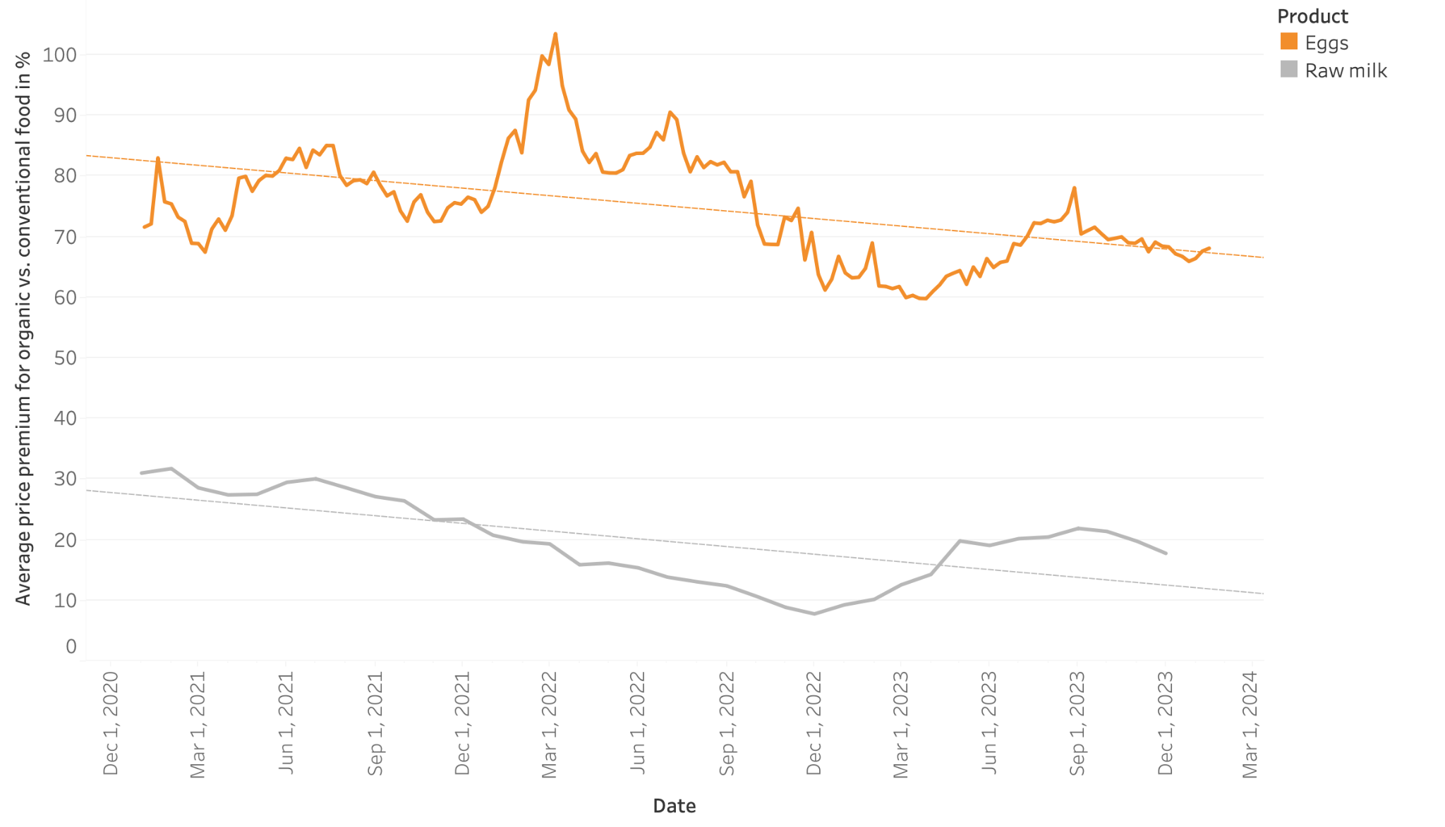
Price premia (i.e., relative price differences) for organic
vs. conventional food: decreasing for eggs and milk
Avg. yearly change of eggs premium: –5.0 pp
Avg. yearly change of milk premium: –5.1 pp
Price premia much higher for eggs (currently 68.1%) than for milk (17.8%)
Data: from API “Agri-Food Markets” by European Commission*;
EU 27 countries except Luxembourg;
N = 13,606 cases
* https://agridata.ec.europa.eu/extensions/DataPortal/agricultural_markets.html

Slide 23
Hypothesis on prices supported
Prices for organic (vs. conventional) eggs and milk in the EU are decreasing.

Slide 24
Consumer motives
for buying organic foods
What consumer expectations should I fulfill if I want to produce organic food for the EU market?

Slide 25
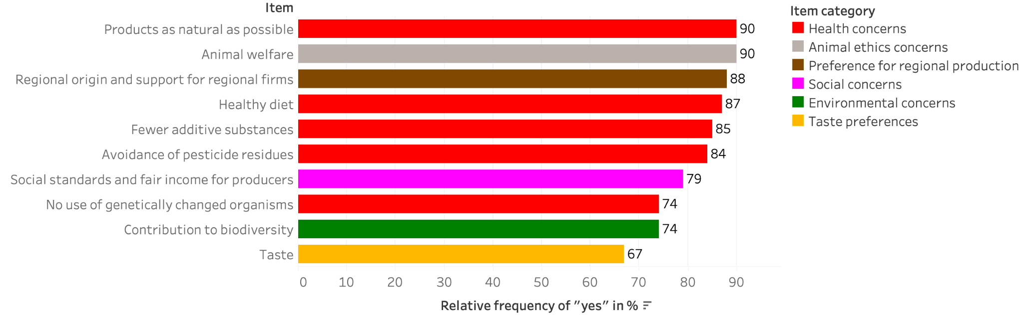
Most consumers of organic foods in Germany care about health aspects and animal ethics.
Reasons for buying organic foods (among people who buy organic foods at least occasionally):
Data:
from Eco Survey (Öko-Barometer) 2022 by German Federal Ministry of Food and Agriculture*;
Germany, age ≥ 14;
N = 859 respondents
* https://www.bmel.de/SharedDocs/Downloads/DE/_Landwirtschaft/Biologischer-Landbau/oeko-barometer-2022-tabellenband.html

Slide 26
Hypothesis on consumer motives supported
Motives for buying organic foods (among those who buy them) include health and environmental concerns.

Slide 27
Conclusions
Thank you for your attention!
Should I produce organic or conventional food?
Food producer in the EU
Demand perspective for organic foods generally positive
(if inflation decreases again)
Price perspective for organic foods challenging, especially in case of milk
Profit effects of organic production depend also on costs.
Consumers of organic foods are especially interested in health aspects and animal welfare.
⇒ Important to meet these expectations

